Slide 1

Capstone Project – I: Review – 1 on
Secure QR Payment Using Visual Cryptography
Presented by the Batch No. : Team 10
Harsha Rajoor BU21CSEN0400241(TL)
Abdul Kalam BU21CSEN0400254
Tharun G V BU21CSEN0400267
Nirajkumar BU21CSEN0400239
Under the Guidance of
Gopal Murugan
Associate Professors
Department of Artificial Intelligence & Data Science
GITAM School of Technology, GITAM (Deemed to be University),
Bengaluru, Karnataka, INDIA.

Slide 2
CONTENTS
Abstract
Introduction
Literature Survey
Conclusion
Technical Approach
References

Slide 3
Abstract
Modified Statement : Secure Asset Verification and Authentication System using Decentralized Ledger Technology and Visual Cryptography-Enhanced QR Codes, in Payment Systems
This project introduces a system that integrates blockchain with visual cryptography-enhanced QR codes to improve data security, privacy, and trust. Blockchain's decentralized and immutable nature provides a secure foundation for storing sensitive information, while visual cryptography splits data into encrypted shares embedded in QR codes. These shares can only be combined to reveal the original information, ensuring privacy. Smart contracts automate and verify transactions, enabling secure, transparent data handling. Potential applications include secure financial transactions, digital identity management, and supply chain transparency, offering decentralized, secure ecosystems for users.

Slide 4
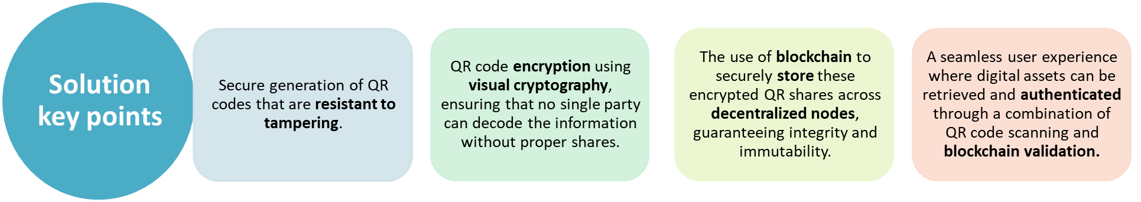
Introduction
Background:
In recent years, decentralized and distributed ledger technologies (DLT) such as blockchain have transformed how digital assets like cryptocurrencies and NFTs are created, managed, and exchanged. These technologies ensure that digital assets are tamper-proof, transparent, and secure. However, secure access and verification of such assets remain a challenge, especially when users need to prove ownership, perform transactions, or share sensitive information without compromising security.
The challenge is to develop a solution that merges DLT for decentralized storage and tracking of digital assets with visual cryptography-based QR codes for secure, easy-to-use access and verification.

Slide 5
Use Cases:
NFT Provenance Verification:
Supply Chain Traceability:
  Artists can prove the authenticity of their NFTs using visual cryptography to encode ownership information, which is stored on the blockchain and can only be unlocked with the right set of QR shares.
Digital Identity Management:
  Ensure secure and tamper-proof tracking of products through QR codes, where each step in the supply chain is logged on the blockchain and accessible only through the proper QR code shares.
Secure Financial Transactions:
  Securely store and manage digital identity credentials in a decentralized manner, allowing users to verify their identity across platforms by scanning QR codes encrypted with visual cryptography.
  Users can securely store and access cryptocurrency wallets using visual cryptography-enhanced QR codes, ensuring that even if a single QR share is compromised, unauthorized access is impossible without combining all required shares.

Slide 6
Literature Survey
Table 1:Visual Cryptography
Title: Design and Implementation of a Secure QR Payment System Based on Visual Cryptography
S. No | Paper Details | Summary | Techniques/Algorithms Used | Research Gap
1 | Authors: Lina Ahmad, Rania Al-Sabha, Ali Al-Haj Affiliation: Department of Computer Engineering, Princess Sumaya University for Technology, Amman, Jordan Published in: 7th International Conference on Information Management (ICIM) 2021 DOI: 10.1109/ICIM52229.2021.9417129 Publisher: IEEE | The paper proposes a secure online payment system based on QR codes enhanced by visual cryptography. The motivation behind the research is the increasing vulnerability of online payment systems to attacks such as data theft, fraud, and impersonation. The system consists of a mobile application, a cloud server, and uses (2, 2) Visual Cryptography Scheme (VCS) to split the QR code data into two shares, one stored on the server and one provided to the merchant or consumer. This ensures that the QR code cannot be tampered with, as both shares are required to validate the transaction. The application allows users to generate or scan QR codes for payment processing securely, protecting user information and ensuring transaction integrity​ | Visual Cryptography Scheme (VCS) QR Code Encryption and Decryption Android Application (Java) Payment Gateway Server (Python) | Public Key Cryptography Limitations Static QR Codes Multithreading for Performance

Slide 7
Title: Design of Secure QR Payment System Using Visual Cryptography Method
S. No | Paper Details | Summary | Techniques/Algorithms Used | Research Gap
2 | Authors: Dr. Praveena Narayanan, G. Chethan Teja Kumar, Yadlapalli Lokesh, B. Bhavya, P. Charitha, S. Hemalatha Affiliation: Madanapalle Institute of Technology & Science, India Published in: 2023 International Conference on Computer Communication and Informatics (ICCCI) DOI: 10.1109/ICCCI56745.2023.10128604 Date of Publication: January 23–25, 2023​ | The proposed system operates by converting a URL into a QR code, encrypting this QR code using visual cryptography, and then further encoding the encrypted result into another QR code. The paper outlines how the system enhances security by ensuring that only users with the decryption tool can access the payment link. The system is implemented through a web application built using the Django framework in Python, providing a user-friendly platform for generating, encrypting, and scanning secure QR codes | Visual Cryptography Scheme (VCS) QR Code Encryption and Decryption Web Application (Django Framework) RSA Encryption Algorithm | Efficiency of Cryptographic Techniques Emerging Technologies Deep Learning for Fraud Detection

Slide 8
Title: Mobile Payment Authentication Using QR Code Based on Visual Cryptography Scheme
S. No | Paper Details | Summary | Techniques/Algorithms Used | Research Gap
2 | Authors:Deny Ahmad Sofyan, Satria Mandala, Erwid M. Jadied, Publication: 2024 2nd International Conference on Software Engineering and Information Technology (ICoSEIT) DOI:10.1109/ICoSEIT60086.2024.10497482​ | The paper focuses on enhancing the security of mobile payment systems using QR codes by integrating Visual Cryptography (VC) with Extended Visual Cryptography Schemes (EVCS). The goal is to protect against attacks such as QR code manipulation. The proposed system uses a Bit-level Visual Cryptography Scheme and Steganography to embed the pixel data from shared images into a carrier image. This ensures that the resulting image is both secure and recognizable by QR code readers. The method aims to address the weaknesses in current mobile payment security by providing high-level encryption without degrading the visual quality of the QR codes. | Visual Cryptography Scheme (VCS) Extended Visual Cryptography Scheme (EVCS) Bit-level Visual Cryptography Steganography Performance Metrics | image quality Existing solutions

Slide 9
Title: Secure E-Payment Method Based on Visual Cryptography
S. No | Paper Details | Summary | Techniques/Algorithms Used | Research Gap
2 | Authors: Trihastuti Yuniati, Rinaldi Munir Publication: 2018 3rd International Conference on Information Technology, Information Systems, and Electrical Engineering (ICITISEE) DOI: 978-1-5386-7082-8/18/$31.00 ©2018 IEEE | This paper introduces a secure e-payment method that leverages Visual Cryptography (VC) to enhance security in online payment transactions. It aims to prevent phishing and identity theft, which are common in online shopping, by utilizing VC during key processes like registration, credit card verification, and payment authorization. VC is applied to CAPTCHA images, credit card details, and QR codes containing One-Time Passwords (OTP) to ensure the authenticity and confidentiality of transactions. The proposed method enhances security without requiring merchants to store sensitive user information, significantly reducing the risks associated with data theft​ | Visual Cryptography (VC) One-Time Password (OTP) Steganography CAPTCHA | Lack of Effective Anti-Phishing Methods Absence of Secure E-Payment Systems Using VC Challenges in User Experience

Slide 10
Table 2: Block Chain
Title: A Blockchain-Based Scheme for Secure Data Offloading in Healthcare With Deep Reinforcement Learning
S. No | Paper Details | Summary | Techniques/Algorithms Used | Research Gap
2 | Authors: Qiang He, Zheng Feng, Hui Fang, Xingwei Wang, Liang Zhao, Yudong Yao, Keping Yu Affiliations:Northeastern University, ChinaShanghai University of Finance and Economics, ChinaStevens Institute of Technology, USAHosei University, Japan Published in: IEEE/ACM Transactions on Networking Date of Publication: February 2024 DOI: 10.1109/TNET.2023.3274631 | The paper proposes a secure data off loading system for healthcare environments using blockchain technology integrated with Mobile Edge Computing (MEC). The system addresses the challenges posed by the rapid growth of medical IoT (Internet of Things) devices, which generate massive amounts of sensitive data. Traditional cloud computing methods fail to handle such volumes efficiently due to high latency. To mitigate these issues, the paper presents a blockchain-based architecture that ensures data security during offloading while optimizing costs such as energy consumption and delay. The scheme uses smart contracts for secure data audits during offloading and employs a deep reinforcement learning algorithm—specifically an Asynchronous Advantage Actor-Critic (A3C) model—to optimize resource allocation and minimize costs | Blockchain Technology Smart Contracts Deep Reinforcement Learning (A3C Algorithm) Mobile Edge Computing (MEC) | Integration Challenges Cost Optimization and Energy Consumption Smart Contract Efficiency

Slide 11
Table 3: DLT
Title: IEEE Standard for Distributed/Decentralized Exchange Framework using Distributed Ledger Technology
S. No | Paper Details | Summary | Techniques/Algorithms Used | Research Gap
2 | Publisher: IEEE Consumer Technology Society, Blockchain Standards Committee Published: April 13, 2023 Approved: February 15, 2023 | This document defines an extension framework based on IEEE Std 2140.1™-2020, leveraging Distributed Ledger Technology (DLT) to facilitate decentralized exchanges. The standard incorporates smart contracts to manage and process transactions, replacing the need for traditional exchange operators. It outlines extensible interfaces for supporting financial derivatives through tokenized systems. The standard ensures transparency, security, and efficiency in managing decentralized financial exchanges while also accommodating regulatory and audit needs. | Automated Market Makers (AMM) Smart Contracts Tokenization Blockchain Oracles Security and Audit Functions | The document focuses on enabling decentralized exchanges within a single blockchain, but mentions the need for more exploration in cross-chain decentralized exchanges

Slide 12

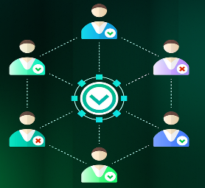
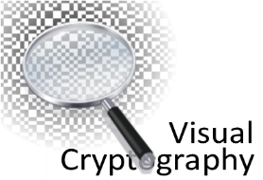

TECHNICAL APPROACH
 | Tech | Uses
 | BlockChain | Blockchain provides decentralized, tamper-proof storage, ensuring the security and integrity of visual cryptographic shares. It also enables automated verification through smart contracts for secure data handling and transparent tracking.
 | DLT | Distributed Ledger Technology (DLT) ensures secure, decentralized storage and sharing of visual cryptographic shares across multiple nodes. It provides transparency and prevents tampering, enhancing the system's overall security and reliability.
 | Visual Cryptography | Visual cryptography securely splits sensitive information into encrypted shares, which are embedded in QR codes. Only by combining all the shares can the original data be reconstructed, ensuring privacy and protection against unauthorized access.
 | Cloud Service | Cloud services provide scalable infrastructure for storing and processing cryptographic shares and blockchain data.
 | Mobile Application | :A user friendly mobile application

Slide 13
Conclusion
This project introduces a system that integrates blockchain with visual cryptography-enhanced QR codes to improve data security, privacy, and trust. Blockchain's decentralized and immutable nature provides a secure foundation for storing sensitive information, while visual cryptography splits data into encrypted shares embedded in QR codes. These shares can only be combined to reveal the original information, ensuring privacy. Smart contracts automate and verify transactions, enabling secure, transparent data handling. Potential applications include secure financial transactions, digital identity management, and supply chain transparency, offering decentralized, secure ecosystems for users.

Slide 14
References
Journals
S. Nakamoto, “Bitcoin: A peer-to-peer electronic cash system,” Decentralized Bus. Rev., 2008, Art. no. 21260.
V. Buterin , “A next-generation smart contract and decentralized application platform,” White Paper, vol. 3, no. 37, pp. 2–1, 2014.
L. Zhong, Q. Wu, J. Xie, J. Li, and B. Qin, “A secure versatile light payment system based on blockchain,” Future Gener. Comput. Syst., vol. 93, pp. 327–337, Apr.2019
A Centralized Data Validation System Model for Healthcare Systems Based on Blockchain, Year: 2021, Pages: 55-58DOI,Bookmark: 10.1109/ICSIoT55070.2021.00019
Design of a Blockchain-Based Secure Storage Architecture for Resource-Constrained Healthcare,Year: 2023, Pages: 1-6DOI Bookmark: 10.1109/ISCC58397.2023.10218178

Slide 15

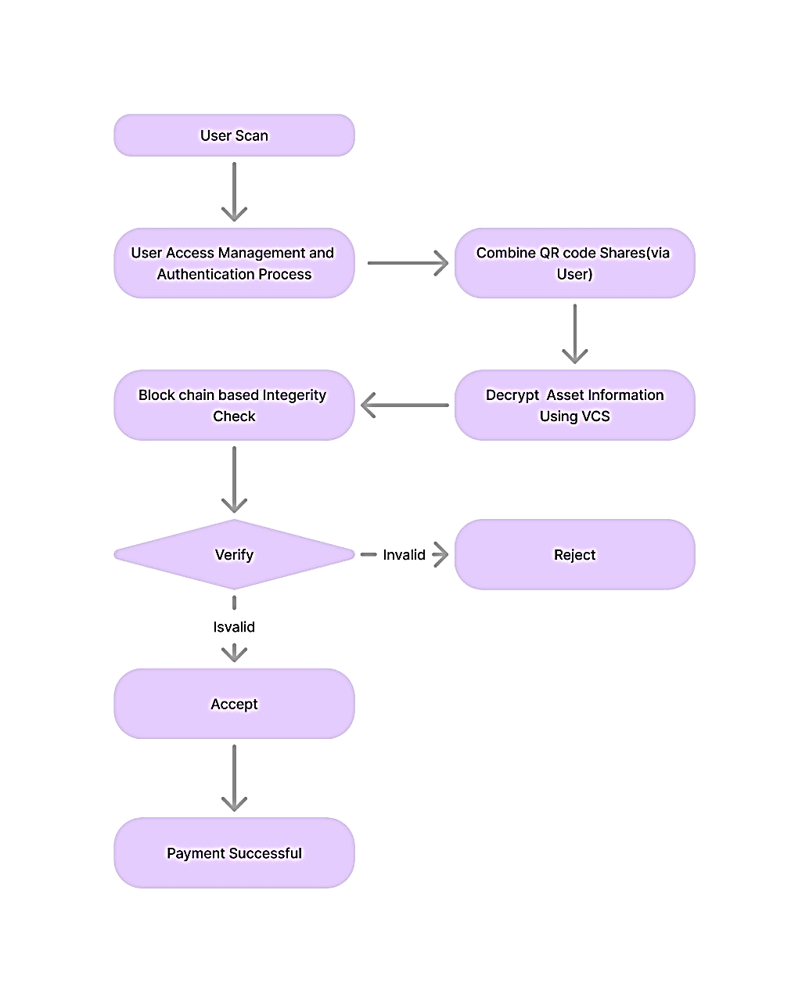
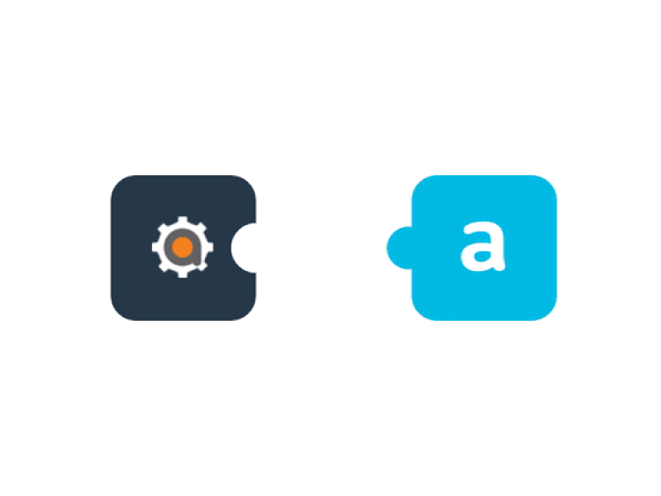
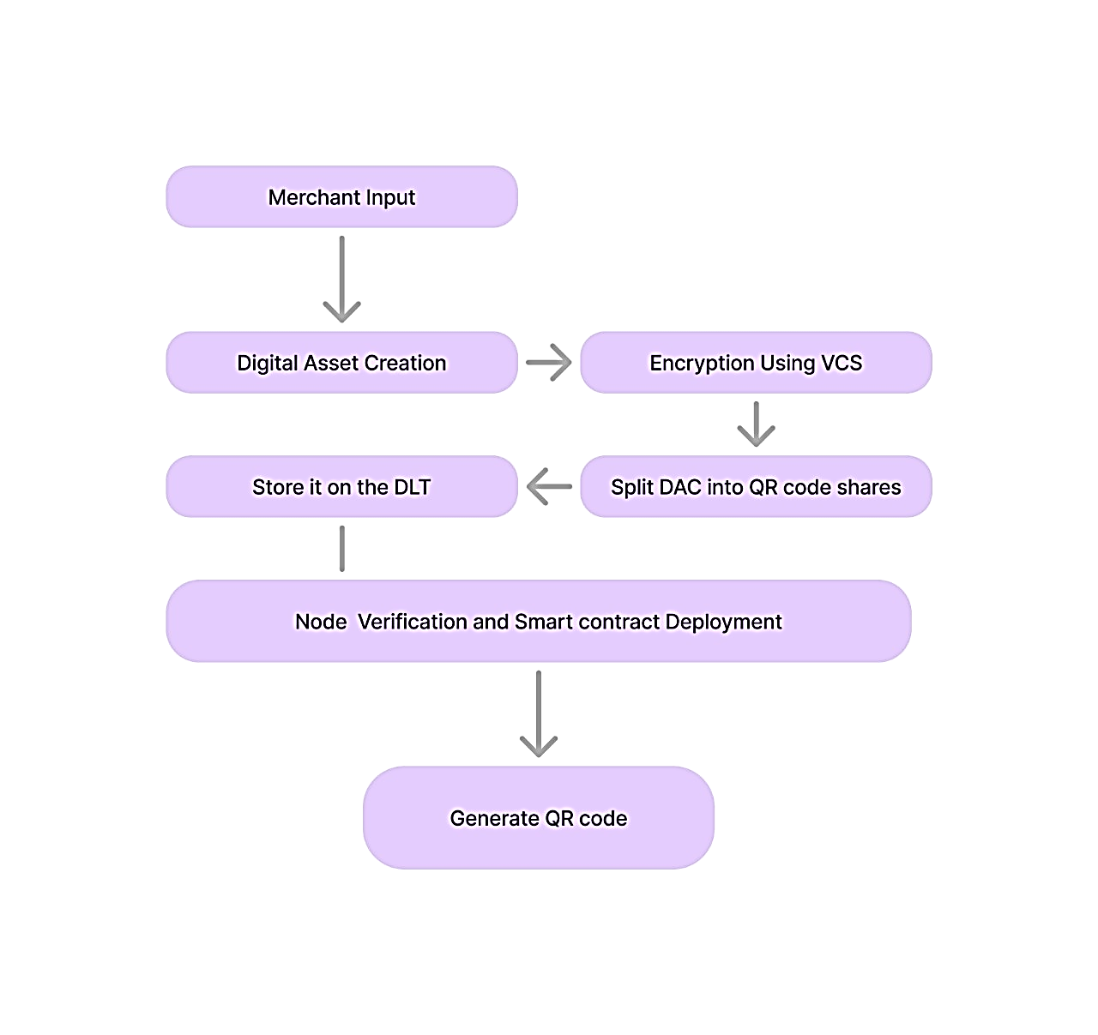

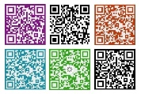

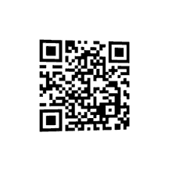


TECHNICAL APPROACH-Flow Chart
Visual Cryptographic System
a cryptographic technique which allows visual information (pictures, text, etc.) to be encrypted in such a way that the decrypted information appears as a visual image
Status : The systems flow design and encryption method are designed and the blockchain method is to be initialize using AWS

Slide 16







TECHNICAL APPROACH
Tech Stack:
ReactNative : FrontEnd, An Creative UI/UX Design
NodeJs : BackEnd , The logic Part of the process(Encryption, storing,redirecting)
Solona : Blockchain, DLT Technology for asset confidentiality
MongoDB : Database, For interaction with database
Python : Encryption Algorithams
AWS (Amazon Web Services): Cloud and Hosting
OpenCV :Image Processing/React Native QR

